Slide 1
Web Technologies
Lab-IV
JavaScript Math, String, Array, Number

Slide 2
This Lecture
• Functions continued
• Inbuilt objects
–
Math, String, Array, Number
• Debugging JavaScript
4

Slide 3
Creating a Function to Perform an Action
• Syntax of a JavaScript function
function function_name(parameters){
JavaScript commands
}
• Calling a function
function_name(parameter values)
6

Slide 4
Creating a Function to Return a Value
• For a function to return a value
–
It must include a return statement
• Syntax of a function that returns a value
function function_name(parameters) {
JavaScript commands
return value;
}
7

Slide 5
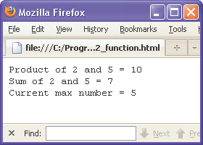
JavaScript Function Example
<head>
<script type="text/javascript">
var curMax = 0;
Global variable:
function product(a,b)
{
Can be accessed from any
var result = a*b;
return result;
JavaScript on page.
}
function sum(a,b)
{
var result = a+b;
return result;
Local variables;
}
Same name ok
function updateMax(a)
{
in different
if (a > curMax)
{
functions.
}
curMax = a;
}
</script>
</head>
<body>
<script type="text/javascript">
var num1 = 2;
var num2 = 5
;
document.writeln(“Product of “+num1+” and “num2+” = “+product(num1,num2));
document.writeln(“Sum of “+num1+” and “num2+” = “+sum(num1,num2));
updateMax(num1);
updateMax(num2);
document.writeln(“Current max number i= “+curMax);
</script>
</body>
9

Slide 6
JavaScript Control Flow
• The previous lecture has briefly touched on the JavaScript
Control Flow, namely
–
Conditional statements
• if, if else …
• switch
–
Iteration or looping
• for
• while
10

Slide 7
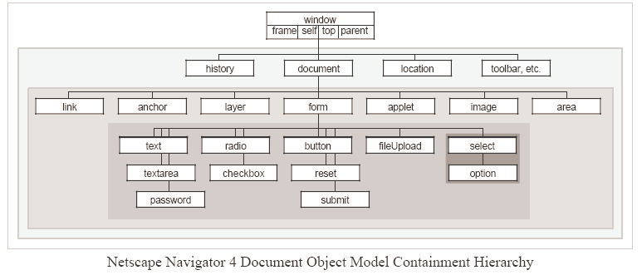
JavaScript Objects
• In-built Global Objects
–
–
Math, String, Array, Number (Rest of this lecture)
Date, RegExp, navigator, Event, screen (Next lecture)
• Document Objects (Subsequent lecture)
11

Slide 8
Window Object
• Window is the root class, so no need to explicitly specify the
class before calling the its functions.
• There are a set of functions that can create pop-up windows to
issue warnings, confirm information and request for user
input. See last lecture for examples.
– alert()
– confirm()
–
prompt()
12

Slide 9
Array
•
Allows one to use one variable to hold more than one value at a time.
• Instead of:
var fruit1 = “apple”;
var fruit2 = “orange”;
array name
var fruit3 = “banana”;
array index starts at 0
• One can write:
var fruits = new Array();
fruits[0] = “apple”;
fruits[1] = “orange”;
// create a new array object
// first item
// second item
fruits[2] = “banana”;
// third item
•
This allows one to use for loops to iterate through whole list.
•
Extremely useful if list is very long (eg 10’s or 100’s items)
13

Slide 10
Three Ways to Create Arrays
• Regular:
var fruits = new Array(); // create a new array object
fruits[0] = “apple”;
// first item
fruits[1] = “orange”;
// second item
• Condensed:
var fruits = new Array( “apple”, “orange”);
• Literal:
var fruits = [ “apple”, “orange”];
14

Slide 11
Accessing and Modifying Array
• One can access an array element by referring to its name and
index number:
var fruits = new Array( “apple”, “orange”);
Output:
document.writeln(“Second fruit = “ + fruits[1]);
orange
• One can easily modify an array element:
var fruits = new Array( “apple”, “orange”);
Output:
fruits[1] = “grape”;
grape
document.writeln(“Second fruit = “ + fruits[1]);
15

Slide 12
Other Array Methods
•
length
Sets or returns the number of elements in an array
•
concat()
Joins two or more arrays, and returns a copy of the joined arrays
•
join()
Joins all elements of an array into a string
•
pop()
Removes the last element of an array, and returns that element
•
push()
Adds new elements to the end of an array, and returns the new length
•
reverse()
Reverses the order of the elements in an array
•
shift()
Removes the first element of an array, and returns that element
•
slice()
Selects a part of an array, and returns the new array
•
sort()
Sorts the elements of an array
•
splice()
Adds/Removes elements from an array
•
toString()
Converts an array to a string, and returns the result
•
unshift()
Adds new elements to the beginning of an array, and returns the new length
•
valueOf()
Returns the primitive value of an array
16

Slide 13
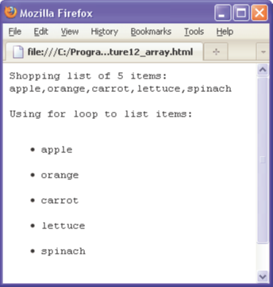
Array concat() and length
concat() – combines arrays
<html><body>
<pre>
<script type="text/javascript">
var fruits = new Array( "apple", "orange");
var veges = new Array( "carrot", "lettuce", "spinach");
var shopping = fruits.concat(veges);
document.writeln("Shopping list of "+shopping.length+" items:");
document.writeln(shopping);
document.writeln("");
document.writeln("Using for loop to list items:");
document.writeln("<ul>");
for(var i=0; i<shopping.length; i++)
{
document.writeln("<li>"+shopping[i]+"</li>");
}
document.writeln("</ul>");
</script>
</pre>
</body></html>
length – gives array length
17

Slide 14
Math Object
• JavaScript provides built in mathematical methods through its
Math objects. The math methods are applied in the following
manner,
SinOfAngle = Math.sin(Angle);
• Some important methods are Math
Math.abs(value)
Math.sin(value)
(absolute value)
(sine of angle value)
Math.round(value) (round value to nearest integer)
Math.ceil(value)
Math.floor(value)
(round up to next integer)
(round down to next integer).
18

Slide 15
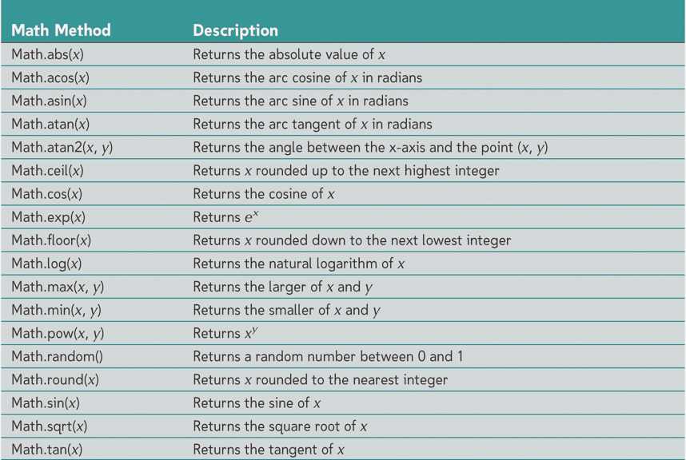
Math Methods
19

Slide 16
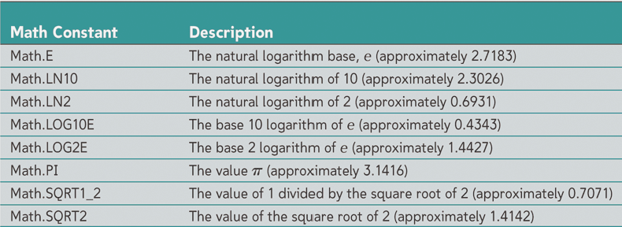
Math Constants
20

Slide 17
Global Numeric Functions
• isFinite() - determines if a value is a finite, legal number
isFinite(1.23);
Returns: true
isFinite(“hello”);
Returns: false
• isNaN() - determines whether a value is an illegal number
isNan(1.23);
Returns: false
isNaN(“hello”);
Returns: true
• parseFloat() - parses string and returns floating number
parseFloat(“1.23”);
Returns: 1.23
• parseInt()
Parses a string and returns an integer
parseInt(“1234”);
Returns: 1234
21

Slide 18
Number Object Functions
var num = 123.456;
• toExponential(x) - converts number to exponential form. num
is optional and specifies # of digits after decimal
num.toExponential();
Returns: 1.23456e+2
num.toExponential(1);
Returns: 1.2e+2
• toFixed(x) - formats number with x digits after decimal
num.toFixed(2);
Returns: 123.45
• toPrecision(x) - formats a number to x length
num.toPrecision(4);
Returns: 123.4
22

Slide 19
Strings Object
• String objects are used to manipulate text.
• Example of how to create a string:
var first_name = “John”;
• length property:
document.writeln(first_name.length);
Output: 4
• Method toUpperCase():
document.writeln(first_name.toUpperCase());
Output: JOHN
• Method toLowerCase():
document.writeln(first_name.toLowerCase());
Output: john
23

Slide 20
Strings Object Continued
var first_name = “John”;
• charAt(index) returns character at the index:
document.writeln(first_name.charAt(2);
Output: h
• concat(str) returns copy of given string joined with str:
document.writeln(first_name.concat(“ny”));
Output: Johnny
• replace(str1, str2) – replaces substring str1 with str2:
document.write(first_name.replace("hn","e"));
Output: Joe
• substr(start,len) – extracts substring of len characters long
starting at index start
document.write(first_name.substr(1,2));
Output: oh
24

Slide 21
Other String Methods
•
charCodeAt()
Returns the Unicode of the character at the specified index
•
fromCharCode()
Converts Unicode values to characters
•
indexOf()
Returns position of first found occurrence of specified value in string
•
lastIndexOf()
Returns position of last found occurrence of specified value in string
•
match()
Searches for match between regular expression and string, and
returns the matches
•
search()
Searches for a match between a regular expression and a string, and
returns the position of the match
•
slice()
Extracts a part of a string and returns a new string
•
split()
Splits a string into an array of substrings
•
substring()
Extracts the characters from a string, between two specified indices
•
valueOf()
Returns the primitive value of a String object
25

Slide 22
List of Exercises
1. Write a JavaScript function to move an array element from one position to another.
Test Data: console.log(move([10, 20, 30, 40, 50], 0, 2)); [20, 30, 10, 40, 50] console.log(move([10, 20, 30, 40, 50], -1, -2)); [10, 20, 30, 50, 40]
2. Write a JavaScript function to generate an array between two integers of 1 step length.
Test Data : console.log(rangeBetwee(4, 7)); [4, 5, 6, 7] console.log(rangeBetwee(-4, 7)); [-4, -3, -2, -1, 0, 1, 2, 3, 4, 5, 6, 7]
3. Write a JavaScript program to find the most frequent item of an array.
Sample array : var arr1=[3, 'a', 'a', 'a', 2, 3, 'a', 3, 'a', 2, 4, 9, 3]; Sample Output : a ( 5 times )

Slide 23
Pre-lab Viva Questions
What is JavaScript?
Name some of the JavaScript features.
What are the advantages of using JavaScript?
What are disadvantages of using JavaScript?
Is JavaScript a case-sensitive language?
How can you create an Object in JavaScript?
How can you read properties of an Object in JavaScript?
How can you create an Array in JavaScript?
How to read elements of an array in JavaScript?
What is a named function in JavaScript? How to define a named function?

Slide 24
JavaScript References
•
HTML, XHTML and XML (3rd edition - comprehensive), by Patrick Carey, Course
Technology.
•
New Perspectives on JavaScript, by Patrick Carey, Frank Canovatchel - in reserve
collection.
• http://www.w3schools.com/js/js_intro.asp
YouTube Video Lecturers:
https://www.youtube.com/watch?v=xpZLS6R91rQ&list=PLr6-GrHUlVf96NLj3PQq-tmEB6woZjwEl
5

